Slide 1
LECTURE 16 Discrete Random Variables and Distributions

Slide 2
What you will learn in this lecture:
What is a random variable?
What is a discrete random variable?
What is a continuous random variable?
Probability distribution function of discrete random variable
Cumulative distribution function of discrete random variable
Expected value of discrete random variable
Variance of discrete random variable

Slide 3
Random Variables
A random variable (rv) is a function from sample space of an experiment to the set of real numbers. That is a random variable assigns a real numbers to each possible outcome.
Note:
Random variable is a function. It is not a variable and it is not random.
It can be categorized into:
Discrete random variable and
Continuous random variable
3
Notes:
3

Slide 4
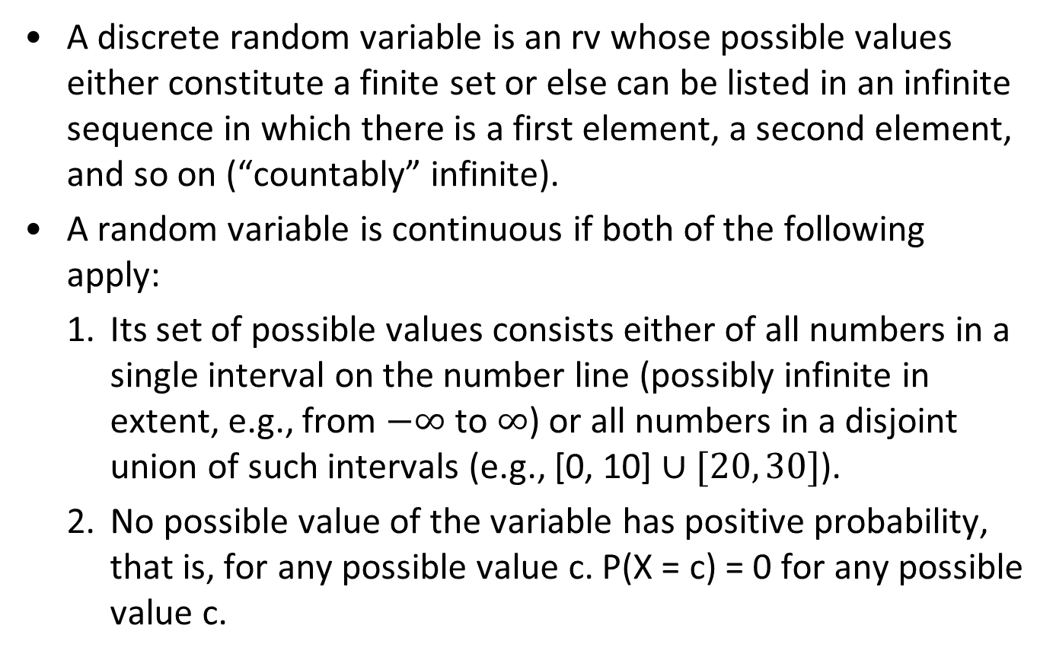
Definition of Discrete and Continuous Random Variables
A discrete random variable is an rv whose possible values either constitute a finite set or else can be listed in an infinite sequence in which there is a first element, a second element, and so on (“countably” infinite).
A random variable is continuous if both of the following apply:
1. Its set of possible values consists either of all numbers in a single interval on the number line (possibly infinite in extent, e.g., from $−∞$ to $∞$) or all numbers in a disjoint union of such intervals (e.g., [0, 10] $∪[20, 30]$).
2. No possible value of the variable has positive probability, that is, for any possible value c. P(X = c) = 0 for any possible value c.

Slide 5
Example 1
Suppose that a coin is flipped three times. Let X(t) be the random variable that equals to the number of heads appear when t is the outcome.
The experiment has the sample space
S={HHH, HHT, HTH, THH, HTT, HTH, THH, TTT} and
X(t) is the function that maps each of the outcome to a numeric value as follows:
X(HHH) = 3
X(HHT)=X(HTH)=X(THH) = 2
X(HTT)=X(THT)=X(TTH) = 1
X(TTT) = 0

Slide 6
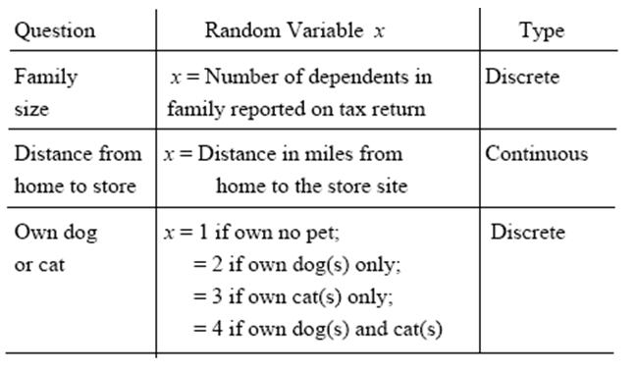
Random Variables
6
Notes:
6

Slide 7
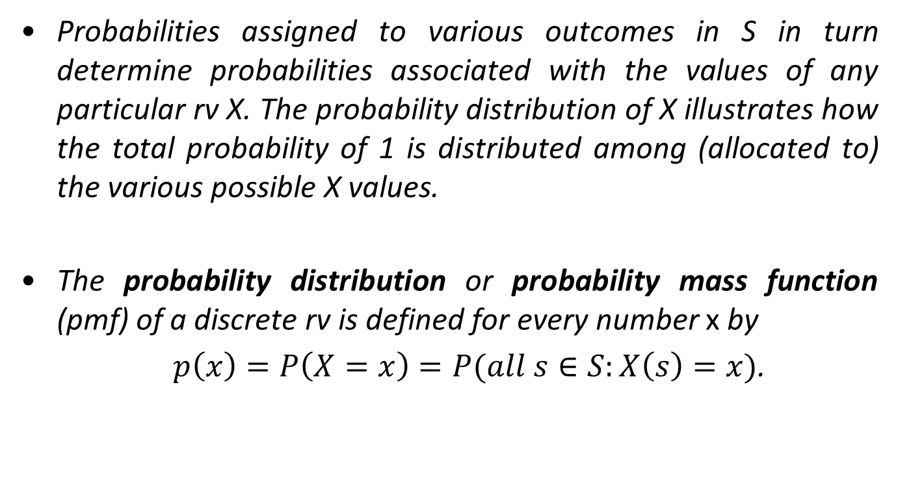
Discrete Random Variables
Probabilities assigned to various outcomes in S in turn determine probabilities associated with the values of any particular rv X. The probability distribution of X illustrates how the total probability of 1 is distributed among (allocated to) the various possible X values.
The probability distribution or probability mass function (pmf) of a discrete rv is defined for every number x by
$p\left(x\right)=P\left(X=x\right)=P(all s∈S:X\left(s\right)=x)$.
7
Notes:
7

Slide 8
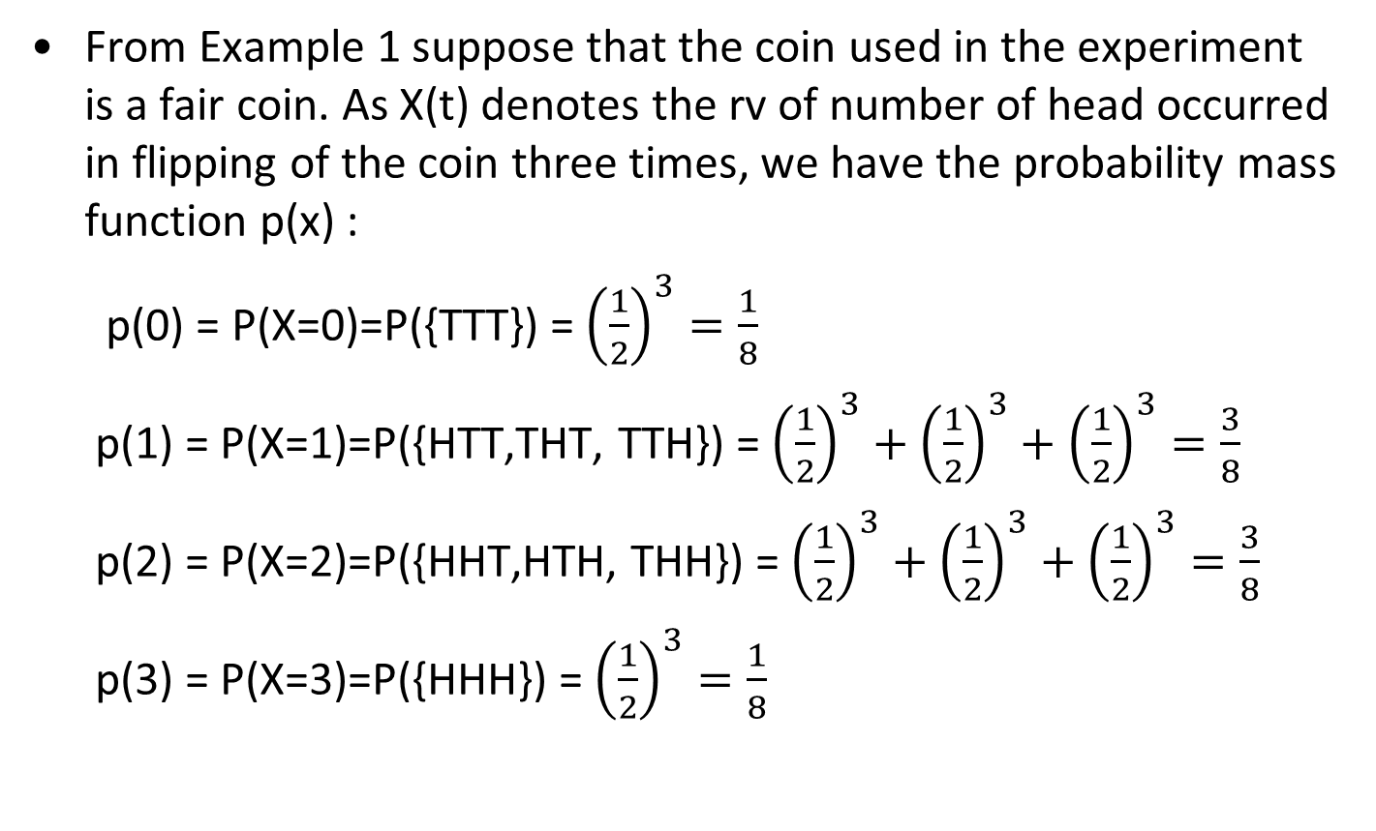
Example 1 (Continue)
From Example 1 suppose that the coin used in the experiment is a fair coin. As X(t) denotes the rv of number of head occurred in flipping of the coin three times, we have the probability mass function p(x) :
p(0) = P(X=0)=P({TTT}) = ${\left(\frac{1}{2}\right)}^{3}=\frac{1}{8}$
p(1) = P(X=1)=P({HTT,THT, TTH}) = ${\left(\frac{1}{2}\right)}^{3}+{\left(\frac{1}{2}\right)}^{3}+{\left(\frac{1}{2}\right)}^{3}=\frac{3}{8}$
p(2) = P(X=2)=P({HHT,HTH, THH}) = ${\left(\frac{1}{2}\right)}^{3}+{\left(\frac{1}{2}\right)}^{3}+{\left(\frac{1}{2}\right)}^{3}=\frac{3}{8}$
p(3) = P(X=3)=P({HHH}) = ${\left(\frac{1}{2}\right)}^{3}=\frac{1}{8}$
8
8
Notes:
8

Slide 9
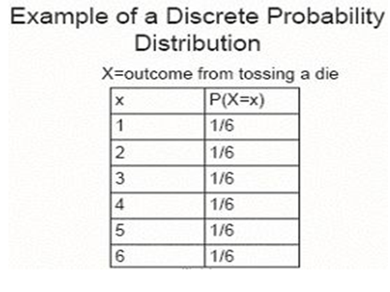
Example 2
Tossing a balance die
Notes:
9

Slide 10
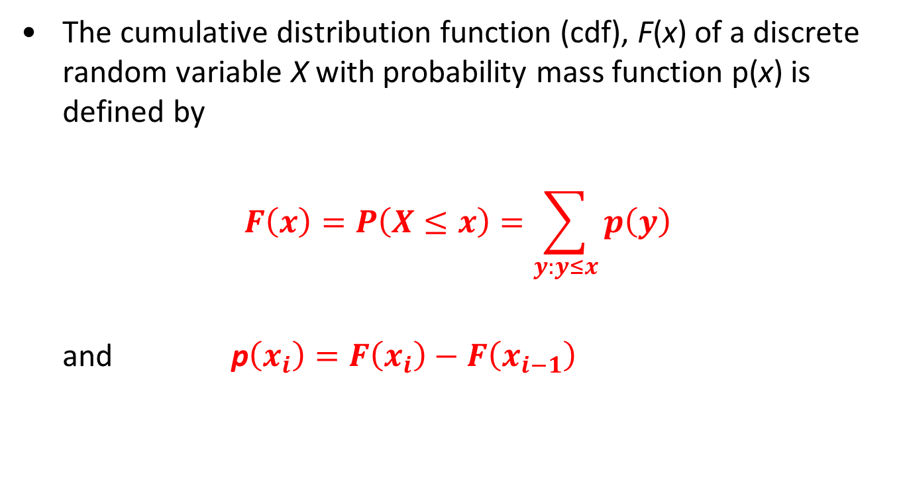
Cumulative Distribution Function
The cumulative distribution function (cdf), F(x) of a discrete random variable X with probability mass function p(x) is defined by
$$F\left(x\right)=P\left(X≤x\right)=\sum_{y:y≤x}{p\left(y\right)}$$
and p$\left(x_{i}\right)=F\left(x_{i}\right)−F\left(x_{i−1}\right)$
10
10
Notes:
10

Slide 11
Example 3
Consider a discrete random variable X with the following pmf. Find the corresponding cdf.
x | 0 | 1 | 2 | 3
p(x) or f(x) | 1/8 | 3/8 | 3/8 | 1/8
F(x) | 1/8 | 4/8 | 7/8 | 1
11
11
Notes:
11

Slide 12
Example 3
x | 0 | 1 | 2 | 3
p(x) or f(x) | 1/8 | 3/8 | 3/8 | 1/8
F(x) | 1/8 | 4/8 | 7/8 | 1
12
Notes:
12

Slide 13
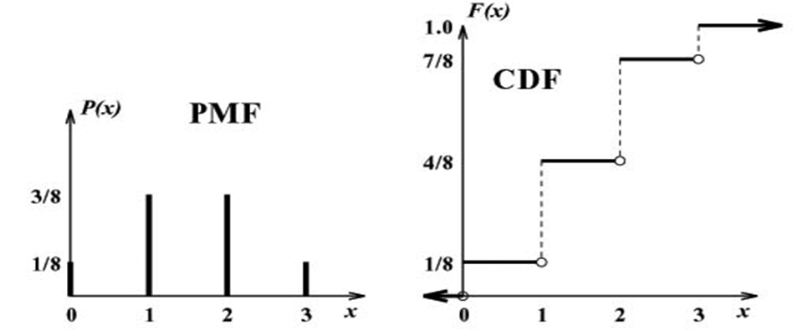
Example3
The pmf and cdf for the previous random variable are:
13
Notes:
13

Slide 14
Example 4
From a box containing four 10 cents and two 5 cents, three coins are selected at random without replacement. Let X be random variable indicate the sum of three selected coins. Find the probability distribution and the cumulative distribution of X.
x | 20 | 25 | 30
p(x) or f(x) | 1/5 | 3/5 | 1/5
F(x) | 1/5 | 4/5 | 1
14
14
Notes:
14

Slide 15
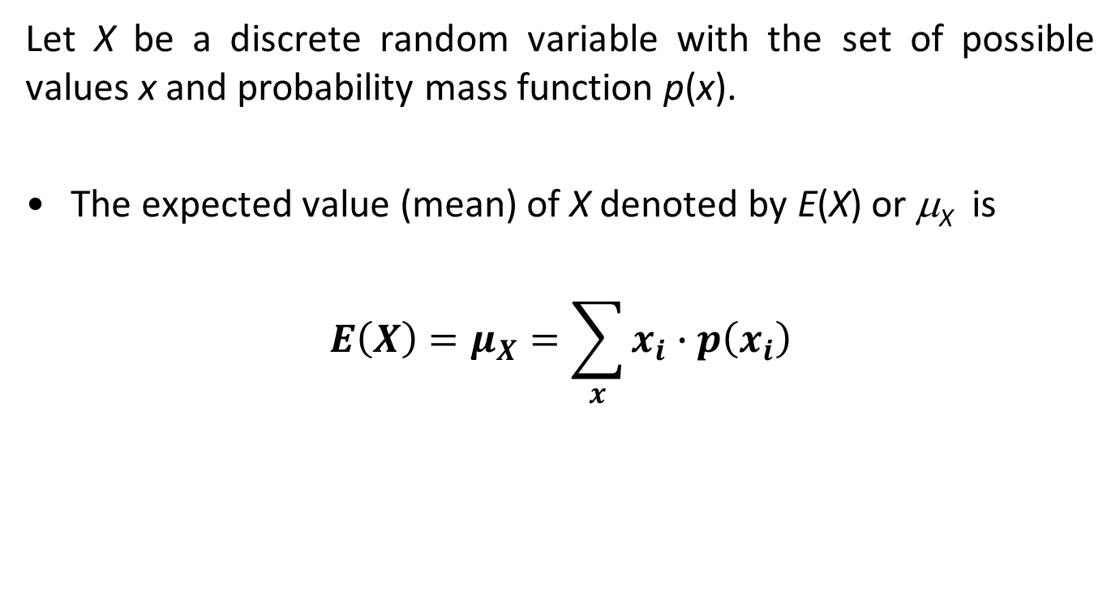
Expected Value of a Discrete Random Variable
Let X be a discrete random variable with the set of possible values x and probability mass function p(x).
The expected value (mean) of X denoted by E(X) or μ_{X} is
$$E\left(X\right)=μ_{X}=\sum_{x}{x_{i}∙p\left(x_{i}\right)}$$
15
15
Notes:
15

Slide 16
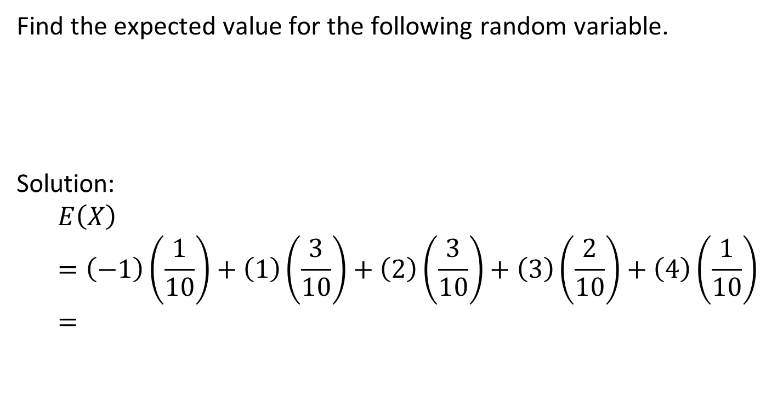
Example 5
Find the expected value for the following random variable.
Solution:
$$E\left(X\right)=\left(−1\right)\left(\frac{1}{10}\right)+\left(1\right)\left(\frac{3}{10}\right)+\left(2\right)\left(\frac{3}{10}\right)+\left(3\right)\left(\frac{2}{10}\right)+\left(4\right)\left(\frac{1}{10}\right)=$$
x | -1 | 1 | 2 | 3 | 4
f(x) | 1/10 | 3/10 | 3/10 | 2/10 | 1/10
16
Notes:
16

Slide 17
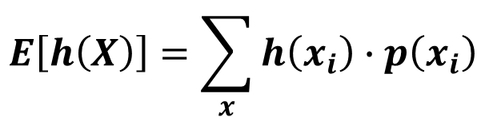
Expected Value of a Function of Discrete Random Variable
Let X be a discrete random variable with the set of possible values x and pmf p(x), the expected value of any function of X, h(X), is given by
$$E\left[h\left(X\right)\right]=\sum_{x}{h\left(x_{i}\right)∙p\left(x_{i}\right)}$$
Notes:
17

Slide 18
Example 6
Let X denotes the number of computer sold per day in an IT shop, and suppose that p(x) is the pmf:
p(0) = 0.1, p(1) = 0.2, p(2) = 0.3, p(3) = 0.4
If the profit function is h(X)=800X − 900.
The mean profit is
E[h(X)]= h(0)p(0) + h(1)p(1) + h(2)p(2) + h(3)p(3)
= (-900)(0.1) + (-100)(0.2) + (700)(0.3) + (1500)(0.4)
= $700
18
18
Notes:
18

Slide 19
Properties of Expected Value
E(a) = a, where a is any constant
E(aX) = aE(X), where a is any constant
E(aX + b) = aE(X) + b, where a, b are any constants
Example 7:
Given E(X) = 5
E(3X) = 3E(X) = 15
E(X - 6) = E(X) – E(6)
= 5 – 6 = - 1
19
19
Notes:
19

Slide 20
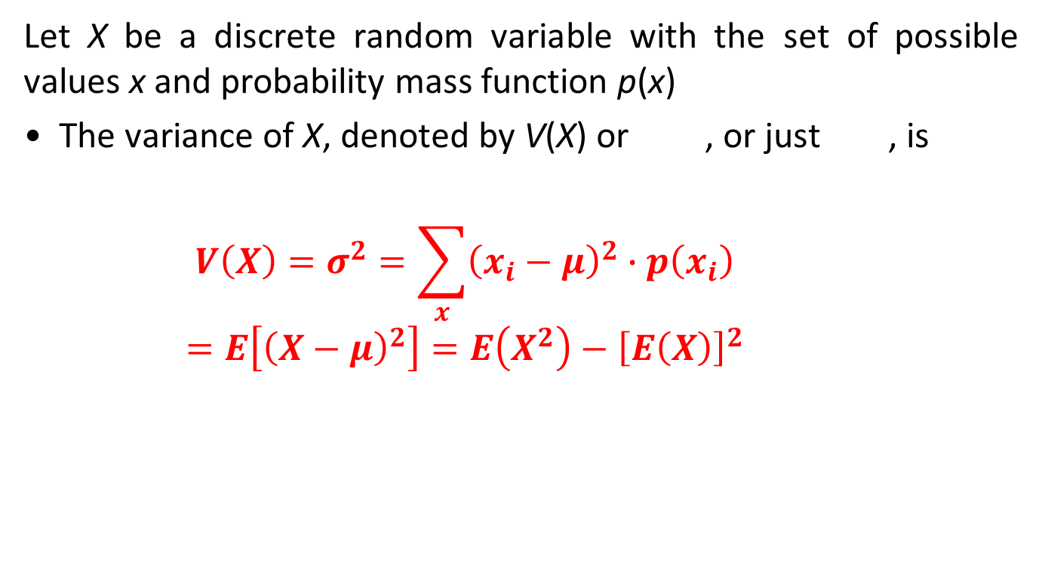
Variance of a Discrete Random Variable
Let X be a discrete random variable with the set of possible values x and probability mass function p(x)
The variance of X, denoted by V(X) or , or just , is
$$V\left(X\right)=σ^{2}=\sum_{x}{{\left(x_{i}−μ\right)}^{2}∙p\left(x_{i}\right)}$$
$$=E\left[{\left(X−μ\right)}^{2}\right]=E\left(X^{2}\right)−{\left[E\left(X\right)\right]}^{2}$$
20
20
Notes:
20

Slide 21
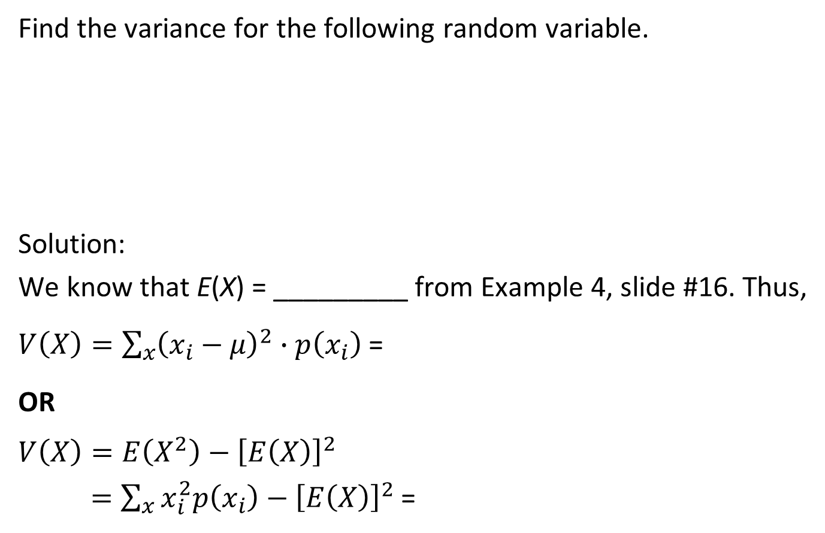
Example 8
Find the variance for the following random variable.
Solution:
We know that E(X) = _________ from Example 4, slide #16. Thus,
$V\left(X\right)=\sum_{x}{{\left(x_{i}−μ\right)}^{2}∙p\left(x_{i}\right)}$ =
OR
$$V\left(X\right)=E\left(X^{2}\right)−{\left[E\left(X\right)\right]}^{2}$$
$=\sum_{x}{x_{i}^{2}p\left(x_{i}\right)−{\left[E\left(X\right)\right]}^{2}}$ =
x | -1 | 1 | 2 | 3 | 4
p(x) | 1/10 | 3/10 | 3/10 | 2/10 | 1/10
21
21
Notes:
21

Slide 22
Properties of Variance
V(a) = 0, where a is any constant
V(aX) = a²V(X), where a is any constant
V(aX + b) = a²V(X) + 0, where a, b are any constants
Example 9:
Given V(X) = 2
V(3X) = 3²V(X) = 18
V(3X - 4) = 9V(X)
= 18
22
Notes:
22

Slide 23
Summary
Materials covered in this lecture?
Random variables (discrete/continuous)
Probability distribution function (probability mass function) of a discrete random variable
Cumulative distribution function of a discrete random variable
Expected value (mean) of a discrete random variable
Properties of expected value
Variance of a discrete random variable
Properties of variance
23

Slide 24
Exercise 1
Let X be the outcome of rolling a die where the odd numbers has twice the probability to appear compared to the even numbers.
1) Construct the pmf and cdf of X.
2) Find the expected value of X.
3) Find the variance of X.
4) Find E(-2X + 4) and V(-2X + 4).

Slide 25
Exercise 2
A certain gas station has six pumps. Let X denote the number of pumps that are In use at a particular time of day. Suppose that the probability distribution of X is as given in the following table; the first row of the table lists the possible X values and the second row gives the probability of each such value.
Find
the value of a.
the cumulative distribution function, F(x).
the probability that at most 2 pumps are in use.
the expected value of X.
the variance value of X.
x | 0 | 1 | 2 | 3 | 4 | 5 | 6
P(x) | 0.05 | 0.10 | 0.15 | a | 0.20 | 0.15 | 0.10

Slide 26
Exercise 3
Suppose a bookstore purchases ten copies of a book at RM6 each to sell at RM12 with the understanding that at the end of a 3-month period any unsold copies can be redeemed for RM2. Let X = the number of copies sold, find the expected net revenue, h(x).

